Slide 1
副词的翻译
Review
汇报人：唐嘉奕
班级：通信2103
汇报时间：2023.5.24

Slide 2
副词
副词在句中主要作修饰成分,用于修饰动词形容间、副词及其他结构以表示程度、方式、时间、地点以及表示说话人对话语的态度等。
副词作状语位于句首
01
02
位于介词与动词之间
位于形容词和介词之间
03
04
在被动语态中的位置

Slide 3
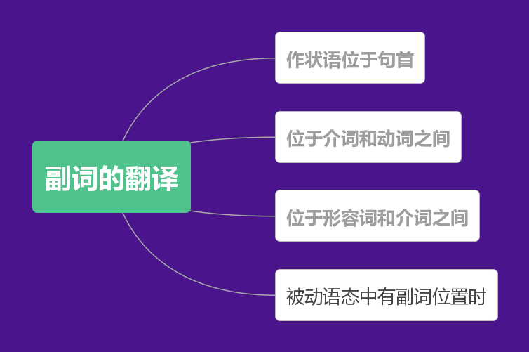
副词作状语时位于句首
1.通常这些参数中有一些是已知的。（parameter）
Usually some of these parameters are known.
2.这样就建立了系统的框架。（systematic framework）
Thus, a systematic framework is established.
3.显然，灯泡里的灯丝断了。（filament灯丝、bulb 灯泡）
Clearly, the filament in the bulb is broken.

Slide 4
不及物动词与介词连用时，副词通常位于介词与动词之间
1.焦炭的主要成分是碳。
（coke、carbon）
Coke consists mainly of carbon.
2.当温度低于临界温度时，电子能自由地通过晶格运动。
(critical、electrons、lattice)
At temperatures below the critical temperature, the electrons move freely throughout the lattice.

Slide 5
在“形容词十介词”的结构中，副词 通常位于形容词和介词之间
“温室效应”主要是由水汽和二氧化碳引起的。
The “greenhouse effect” is due primarily to water vapor and carbon dioxide.
近年来人们对于纸张的日益增长的需求主要是由于人们越来越多地使用因特网。
The growing demand for paper in recent years is due largely to the increased use of the Internet.

Slide 6
被动语态的句子中副词的位置
（1）在没有情态动词或助动词“will”等时,副词往往位于过去分词之前。
病菌很容易从一个人传给另一个人。
Germs are easily passed from person to person.
（2）在有情态动词或“will”等时，有的副词位于“be”之前，有的则位于“be”之后。
这条信息我们经常能在互联网上看到。
The information can usually be found on the Website.
2
3
1
（3）副词位于被动语态的谓语之后。
4
音乐在CD上以数字方式存储。
Music on a CD is stored digitally.

Slide 7

武汉理工大学
ChatGPT
A Chat Robot Program
Driven by AI Technology
通信2103 唐嘉奕

Slide 8
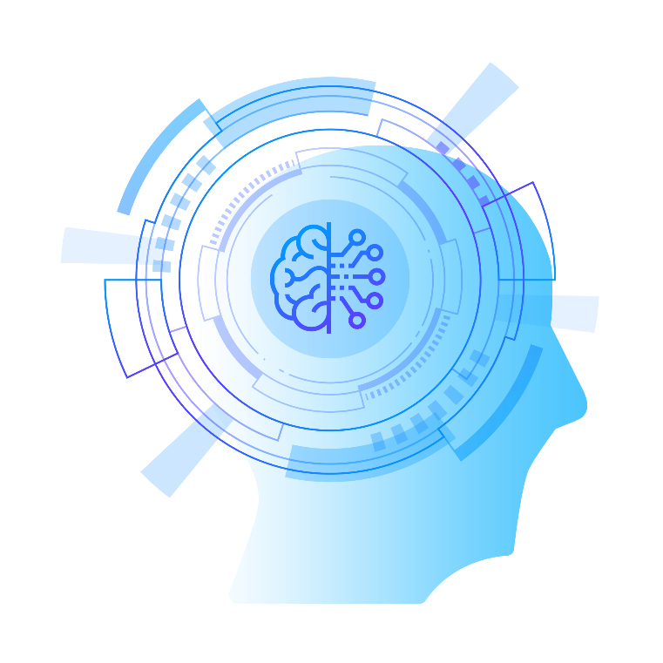

1
PART
简介
ChatGPT (Chat Generative Pre-trained Transformer) is a generative pre trained transformation model developed by the OpenAI team in the United States. At this time, ChatGPT knows astronomy and geography, and can also interact based on the context of the chat. It is not only a chat robot, but also capable of tasks such as writing emails, video scripts, copywriting, translating, and writing code.
ChatGPT（Chat Generative Pre-trained Transformer）全称为生成型预训练变换模型，由美国 OpenAI团队研发。此时的ChatGPT上知天文下知地理，还能根据聊天的上下文进行互动。它不单是聊天机器人，还能进行撰写邮件、视频脚本、文案、翻译 、写代码等任务。

Slide 9
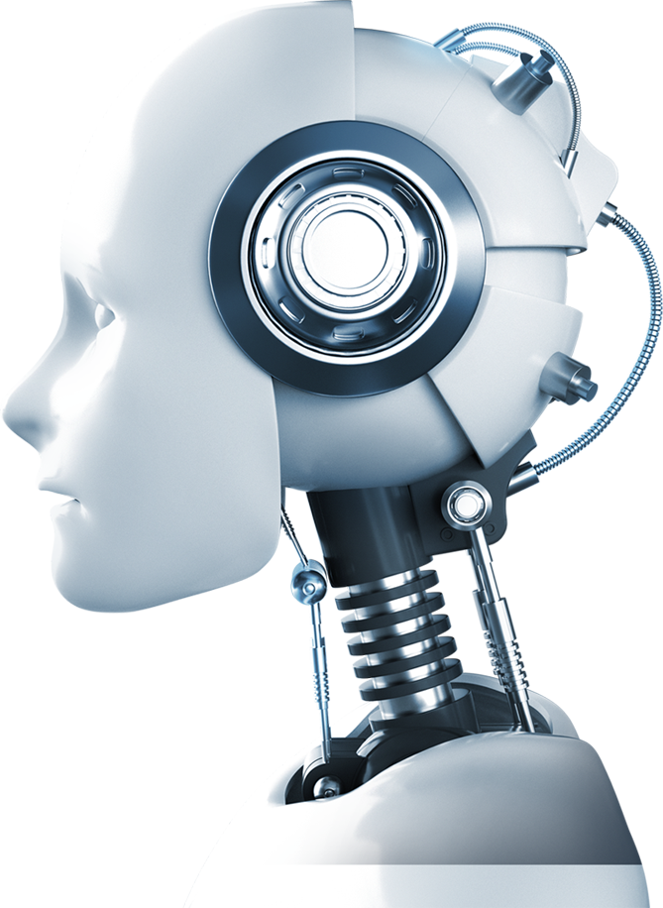
2
PART
Technical Logic(技术逻辑)
GPT is a pre-trained language model based on deep learning, which utilizes large-scale text data preprocessing and model training to enable it to recognize and generate natural language texts. In this process, the model will refer to a large number of conversation samples, learn the rules and features of human language structure, and then generate corresponding answers.
GPT是一个基于深度学习的预训练语言模型，使用了大规模的文本数据预处理和模型训练，使其能够识别和生成自然语言文本。此过程中，模型会参考大量的对话样本，学习到人类语言结构的规则和特征，然后生成相应的回答。

Slide 10

Technical Logic
The emergence of this technology has overturned traditional rule-based chat robots. In the past, robots relied on developers to manually set rules for specific problems, but this method could not cover all situations. The chat robot using the GPT pre-training model has self-learning ability and can continuously learn and improve itself from existing sample data, thus being able to answer user questions more accurately.
这种技术的出现，颠覆了传统的基于规则的聊天机器人。以往的机器人需要依赖开发者针对特定问题进行人工规则的设置，但是这种方法无法覆盖所有情况。而采用GPT预训练模型的聊天机器人，具有自学习能力，可以从已有的样本数据中不断学习和完善自己，因此能够更加准确地回答用户的问题。

Slide 11
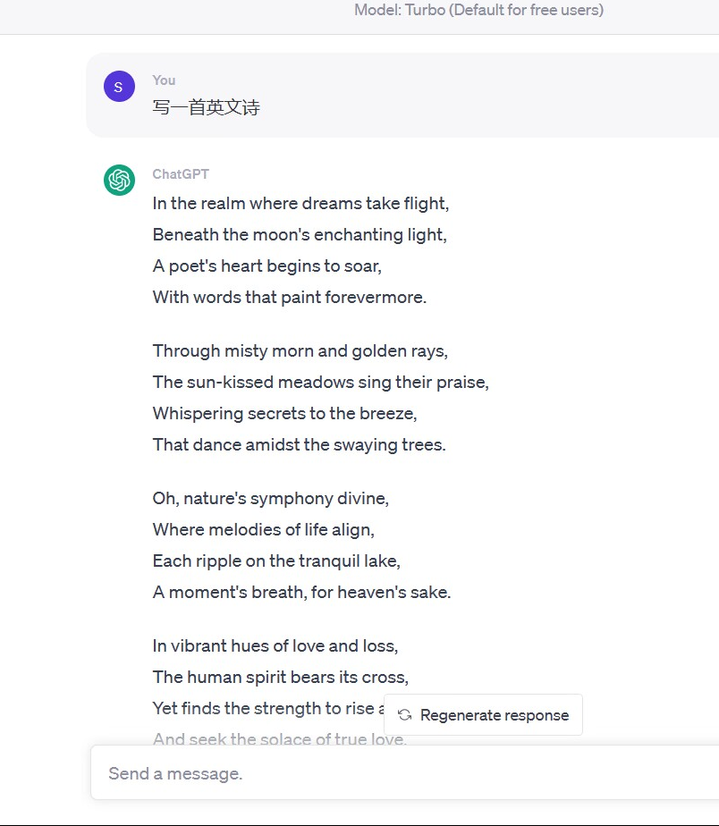
The application scenarios of ChatGPT also include:
Used to develop chat robots, write and debug computer programs, and create works in literature and media related fields, including music, TV dramas, fairy tales, poetry, and lyrics. In certain testing scenarios, ChatGPT performs even better than ordinary human testers in education, exams, and answering test questions.
ChatGPT的应用场景还包括：
用来开发聊天机器人，也可以编写和调试计算机程序，还可以进行文学、媒体相关领域的创作，包括创作音乐、电视剧、童话故事、诗歌和歌词等。在某些测试情境下，ChatGPT在教育、考试、回答测试问题方面的表现甚至优于普通人类测试者。

Slide 12

THANKS

